Slide 1

Precinct Co-Chair Training
Central Committee
Montezuma County Republicans

Slide 2
Please Join Us!
Becoming a Precinct Co-Chair
Republican Central Committee (RCC)
Bylaws permit:
Co-chairs of a Precinct to be appointed by the vacancy committee upon any vacancy.
Appointees voted upon at the next RCC mtg.
At the next Caucus the registered Republican attendees confirm the Co-Chair appointees by vote
Notes:
How presentation will benefit audience: Adult learners are more interested in a subject if they know how or why it is important to them.
Presenter’s level of expertise in the subject: Briefly state your credentials in this area, or explain why participants should listen to you.

Slide 3

What do we believe in?

Slide 4
Duties of the Precinct Co-Chair
Provide relevant information to registered Republican in your Precinct various times each year via many different methods.
Attend RCC meetings monthly
Co-lead the Caucus in the Spring of even numbered years
Be a public representative of the RCC at County functions
Support Republicans Candidates at County & City Elections
Notes:
Lesson descriptions should be brief.

Slide 5
Organizing the Precinct Caucus
Caucus Location
  Find a public or private meeting hall for 30+ people
  Ask for free usage if possible, arrange for key, lighting, heat, tables and chairs
Post the Sign provided to you by RCC Secretary ,
  Outdoors at the meeting site as specified by State Rules.
Notify registered voters in your Precinct Re: the meeting
  Telephone tree calling;
  Word of mouth
  Club announcements
  Social Media
Notes:
Example objectives
At the end of this lesson, you will be able to:
Save files to the team Web server.
Move files to different locations on the team Web server.
Share files on the team Web server.

Slide 6
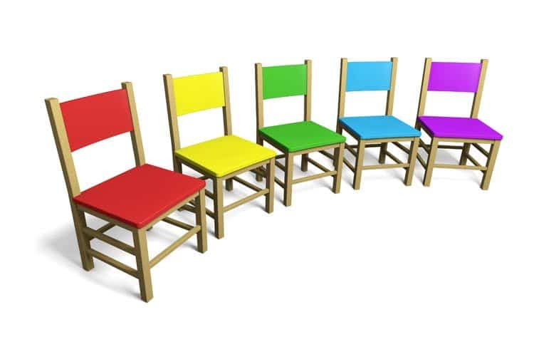
Setting up the Meeting Room
Setting up the meeting room one hour before the doors open…
  Registration tables
  Other tables – for hand outs, raffle tickets, posters
  Chairs, rows or half circles, etc.
  Coffee, Water table

Slide 7

SET UP cont.
  1. Head Table for Precinct Co-Chairs
  2. Flags
  3. Chalk board, computer screen, or large easel paper for viewing materials
  4. Voting slips, writing utensils, tally sheets
  6. Help!!! For Clean up

Slide 8
Facilitating the Meeting
  Calling the meeting to order
  Ground rules: unlocked doors, restrooms, time limits, coffee, water
  Prayer - Pledge
  Election of Caucus Co-chairs
  Secretary is a volunteer to keep notes of meeting speakers, votes, resolutions, etc.
  Tally committee of 3 people
  Meet the registered Republicans with a very quick go around
  Co-Chairs are permitted to rally the participants; encourage attendees to become Delegate; promote candidates you support; and permit members of the meeting to promote candidates that they support
    Prospective Delegates should sign up as they get registered at the door

Slide 9
Primary Business of the Caucus
  Primary business is to elect Delegates to the County Assembly how to nominate & vote
    Prospective Delegates should sign up as they get registered at the door
    Additional Delegates can be nominated during the meeting from the floor but have to be present
    Vote for a specific number of delegates as prescribed by your Precinct instructions
    Part two is to elect seconds to the County Assembly, who may be seated if one or more of the elected Delegates cannot attend on the Assembly date.

Slide 10
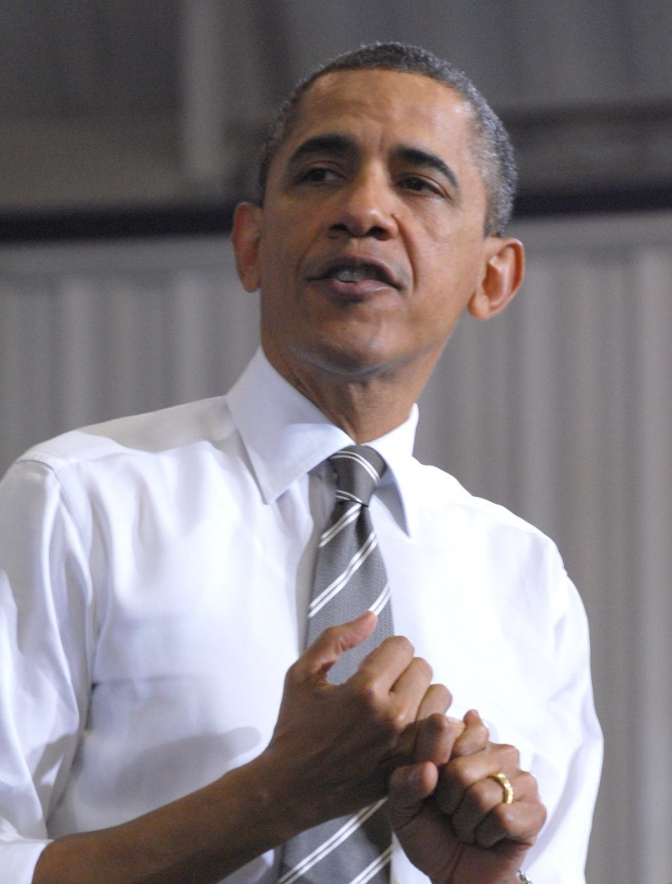
Meet the Candidates
    Time limits set
    Letters may be read by a representative, friend, or Co-Chairs if a candidate cannot attend your Caucus

Slide 11
Offering and Accepting Resolutions
  Resolutions – presented by and rewritten to fit the Assembly Format
    Correctly written with clear description and meaning
    Voted on by the registered Republicans at the Caucus and passed to the RCC the following day for the County Assembly

Slide 12
Moving to the County Assembly
  Follow up with delegates getting them to Attend the Assembly
  Managing your delegation at the Assembly
  The Vote
  Nominations to the State Assemblies
  Keeping the Delegation informed after the Assemblies

Slide 13
Close the Meeting
List

Slide 14
Important Telephone Numbers

